Slide 1
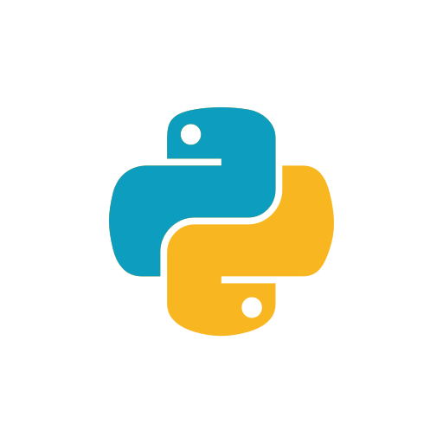

Virtual Environments and Introduction to Django
Pip, Virtual Environments, Django
SoftUni
SoftUni Team
SoftUni
http://softuni.bg

Slide 2
Table of Contents
Installing third-party software with pip
Python virtual environments
Creation, activation and usage
Introduction to Django
Writing our first app
Basic workflow, URLs and Views

Slide 3
Have a Question?
sli.do
#DjangoWeb

Slide 4

HTTP Basics
Requests and Responses

Slide 5



HTTP Basics
HTTP (Hyper Text Transfer Protocol)
Text-based client-server protocol for the Internet
For transferring Web resources (HTML files, images, styles, etc.)
Request-response based
HTTP Request
HTTP Response
Web Client
Web Server

Slide 6



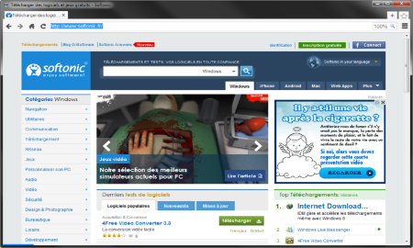





Web Server Work Model
Web Client
Web Server
Technology
Request
Response
Web Resources
Database
HTML, PDF, JPG…

Slide 7
HTTP GET Request – Example
GET /users/SoftUni-Tech-Module/repos HTTP/1.1
Host: api.github.com
Accept: */*
Accept-Language: en
Accept-Encoding: gzip, deflate
User-Agent: Mozilla/5.0 (Windows NT 10.0; WOW64) AppleWebKit/537.36 (KHTML, like Gecko) Chrome/54.0.2840.71 Safari/537.36
Connection: Keep-Alive
Cache-Control: no-cache
<CRLF>
Path to a resource
Headers
Empty Request Body

Slide 8
HTTP Response – Example
Status Code
HTTP/1.1 200 OK
Date: Fri, 11 Nov 2016 16:09:18 GMT+2
Server: Apache/2.2.14 (Linux)
Accept-Ranges: bytes
Content-Length: 84
Content-Type: text/html
<CRLF>
<html>
<head><title>Test</title></head>
<body>Test HTML page.</body>
</html>
Response Headers
Response Body

Slide 9

Installing External Software

Slide 10
What is pip?
A tool for installing Python packages
A package could be a library, a framework or any general piece of code that someone decided to share with the community
pip is a recursive acronym for "Pip Installs Packages"
Packages are hosted at Python Package Index (PyPI)

Slide 11
PIP: General Usage
Verifying that pip is installed:
Installing packages:
Searching for packages:
Getting help:
> pip --version # should print the version number and path
> pip install --user <package name>
> pip search <string>
> pip [optional subcommand] --help

Slide 12
PIP: General Usage (Python > 3.4)
pip is bundled with Python > 3.4
Pip is bundled with Python > 3.4
Installing packages on Windows:
Installing packages on Linux
py -m pip install requests [Package_to_install]
Python3.6 –m pip install [Package_to_install]
py -m pip --version# should print the version number and path

Slide 13
PIP: Example and More Commands
pip install --user pyfiglet // py –m pip install
pyfiglet
> pyfiglet --font basic "Hello, pip" // py -m pyfiglet --font basic "Hello, pip"
Listing our installed packages:
Uninstalling packages:
> pip freeze // py -m pip freeze
Package Name
> pip uninstall pyfiglet // py -m pip uninstall pyfiglet

Slide 14
Python Virtual Environments

Slide 15
Virtual Environments
An isolated copy of a Python installation
This includes:
The Python executable
The Python standard library
Most importantly, user-installed packages
Called site-packages

Slide 16
Virtual Environments: Purpose
Allow different projects with conflicting requirements to coexist
Experiment safely with new libraries
When we need to share our code, we can easily tell exactly what packages our project uses
PyCharm can create virtual environments for you

Slide 17
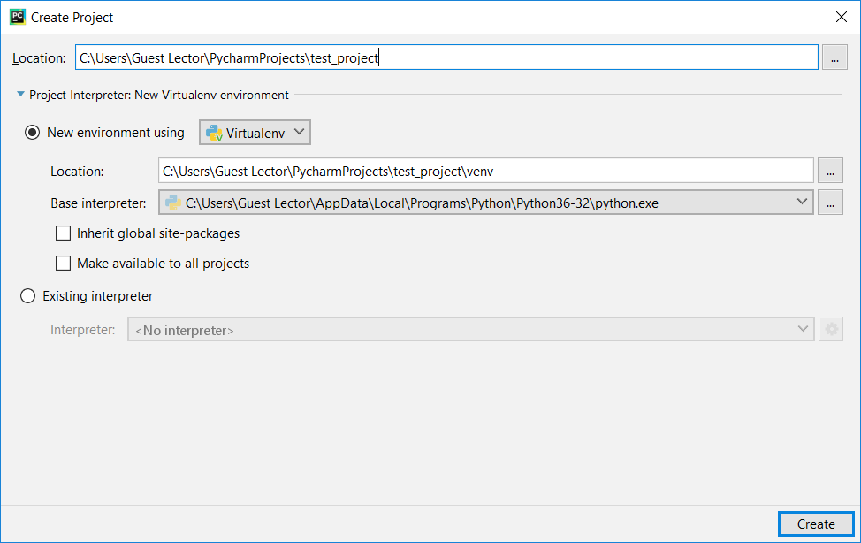
Virtual Environments in PyCharm: Setup
Creation is taken cared if you are using PyCharm
Choose python version

Slide 18
Creating Virtual Environments: Manually
Creates virtual env in specified folder
Creation in a terminal:
Activate:
Deactivate:
python –m venv <venv folder>
On Windows
> venv\Scripts\activate
On Linux/Mac
$ source venv/bin/activate
deactivate

Slide 19
Example: Setting up Virtual Environment
Installing library for performing HTTP requests
Create venv
Notice the updated prompt
> python –m venv venv
> venv\Scripts\activate
(venv) > pip install requests
(venv) > python
>>> import requests
>>> requests
Activate venv
It should be in our venv folder

Slide 20

Making Calls to APIs
Getting real time weather data using requests

Slide 21
Lab: Making API Calls, using requests
There is a public API for weather forecasting at https://openweathermap.org/current
Problem: Use the requests library to get the current temperature from the API
You will need an `app id` and a way to parse json from string
By default the returned temperature is in Kelvins
There is a query parameter that converts it to Celsius
you can find it in the docs

Slide 22
Lab: Making GET Requests from Python
Making the call and parsing the response:
>>> import requests, json
>>> url = 'http://api.openweathermap.org/data/2.5/weather'
>>> url_params = {
... 'q': 'Sofia',
... 'appid': '8f559eafb06742e171487d659c4017a9',
... }
>>> response = requests.get(url, params=url_params)
>>> data = json.loads(response.content)
>>> # TODO: explore `data` and extract some useful information

Slide 23

Frameworks
Definition

Slide 24
Frameworks
Collection of libraries, classes and tools that abstract away details of building applications
Libraries vs. Frameworks
A library is something that you call from your code
A framework is something that calls your code

Slide 25

Django
Introduction and Installation

Slide 26
What is Django?
Free and open-source web framework
Focuses on rapid development and code reusability
Features:
Managing databases
URL Routing
Delivering HTML, CSS and JavaScript
And more…
You can read about Django’s philosophy here

Slide 27
Installing Django
If you have not created a virtual environment, create one
Verify that the installation went fine
> python –m venv myvenv
> myvenv\Scripts\activate
(myvenv) > pip install Django // optional – {Django==1.11}
(myvenv) > python –m django --version

Slide 28
Creating our First Project
Structure and Workflow

Slide 29
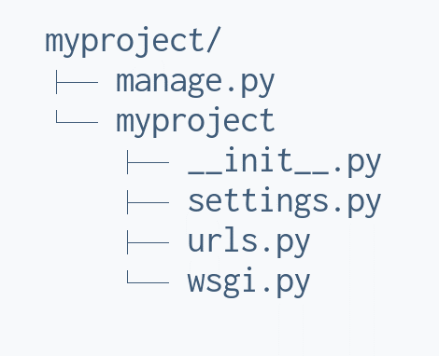
Creation of Projects
Run in the terminal:
Getting help:
(venv) > django-admin startproject <name_of_the_project>
Structure of a project:
django-admin help
django-admin help <subcommand>

Slide 30
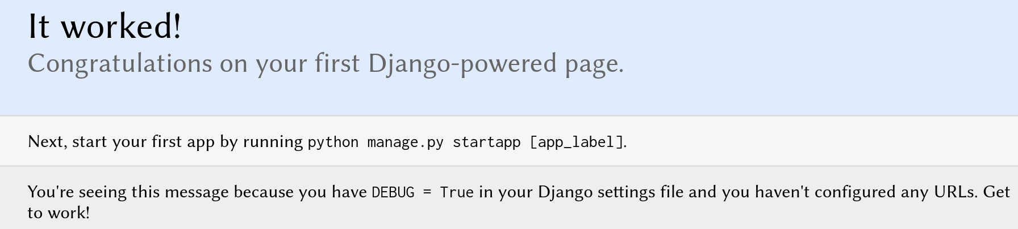
Let's Try it Out
cd (change directory) to the <your project> folder and run:
Open http://127.0.0.1:8000 in your browser and you should see
(venv) > cd <your project folder>
(venv) > python manage.py runserver

Slide 31
Project Structure
manage.py - command-line utility for administrative tasks
urls.py - url declarations, user for routing e.g. http://softuni.bg/index/ will call `my_index`
settings.py - configuration for the project
__init__.py - empty file specifying that the folder is a package

Slide 32
Hello World!
Navigate to the folder where manage.py is
Open myfirstapp\views.py
> cd myproject
> python3 manage.py startapp myfirstapp
from django.http import HttpResponse
def index(request):
return HttpResponse('Hello Django!')

Slide 33
Hello World!
Now we have to tell Django which URL should call our function
We do that by editing myproject\urls.py
from django.contrib import admin
from django.conf.urls import url
from myfirstapp import views as myapp_views
urlpatterns = [
url(r'^admin/', admin.site.urls),
url(r'^$', myapp_views.index, name='index'),
]
Regular
Expressions

Slide 34
Hello World!
Now if we go to the root folder of the project (where manage.py is):
And open http://127.0.0.1:8000 within the browser, or use http CLI
> python manage.py runserver
> http GET 127.0.0.1:8000
HTTP/1.0 200 OK
Content-Type: text/html; charset=utf-8
Server: WSGIServer/0.2 CPython/3.6.6
Hello world

Slide 35
Making simple calculator app

Slide 36
Lab: Calculator App
Make a calculator app with the following API functionality:
Add, subtract, multiply and divide
URL format for the endpoints:
calc/<math operation>/<number>/<number>/
Example input/output:
> http GET 127.0.0.1:8000/calc/add/42/2/
HTTP/1.0 200 OK
{"result": 44}

Slide 37
URLS
If regex groups are present in the URL, they will be passed to the view function
Will result in:
# urls.py
urlpatterns = [url(r'(?P<name>[A-Z][a-z]+)', view_function)]
# views.py
def view_function(request, name):
pass

Slide 38
URLS with path function
url function will be deprecated soon, so better use path
Will result in:
# urls.py
urlpatterns = [path('<name>/', view_function)]
# views.py
def view_function(request, name):
pass

Slide 39
URLS with path function
If regex is necessary better use re_path
Will result in:
# urls.py
urlpatterns = [re_path(r'^(?P<name>[A-Z][a-z]+)/$', view_function)]
# views.py
def view_function(request, name):
pass

Slide 40

Summary
…
…
…
Installing packages with pip
pip install, freeze, uninstall
Virtual Environments
Venv builtin module
Activation script
Django
Views, URLs

Slide 41
https://softuni.bg/courses/programming-fundamentals

Slide 42

License
This course (slides, examples, demos, videos, homework, etc.) is licensed under the "Creative Commons Attribution-NonCommercial-ShareAlike 4.0 International" license

Slide 43





Trainings @ Software University (SoftUni)
Software University – High-Quality Education, Profession and Job for Software Developers
softuni.bg
Software University Foundation
http://softuni.foundation/
Software University @ Facebook
facebook.com/SoftwareUniversity
Software University Forums
forum.softuni.bg

